Slide 1

Integrated Care Systems and Chaos
Andy Brass | University of Manchester

Slide 2




What Are Integrated Care Boards?
ICBs are statutory NHS organisations responsible for planning and funding health services for their local population. Established in July 2022, they replaced Clinical Commissioning Groups (CCGs) and brought together the NHS, local authorities, and other partners.
42 ICBs
£164 Billion
Three Shifts
Covering all of England, each serving populations of 500K to 3M+
Annual NHS budget managed through strategic commissioning
Hospital to community, illness to prevention, analogue to digital

Slide 3
The ICB Strategic Vision
The 2025 Strategic Commissioning Framework positions ICBs as the architects of local health systems — planning, purchasing, monitoring and evaluating services to improve population health and reduce inequalities.
01
Strategic Commissioning
02
Population Health
Evidence-based planning, purchasing and evaluation of services for the long term
Using data to understand needs, reduce inequalities and target interventions
03
Integration
04
Accountability
Breaking silos between NHS, social care, public health and voluntary sector
Creating best value from public money with transparent governance

Slide 4
Question:
- Do healthcare systems show complex dynamics?
Hypothesis:
- Much health care ends in prescription
- Any signal should be visible in prescribing data
Analysis:
- Look at prescribing data from Manchester ICB as a function of time for disorders with complicated pathways

Slide 5
The Psychosis Care Pathway
Early Intervention in Psychosis (EIP) services provide evidence-based care within two weeks of referral. Here is the pathway a patient follows:
Recognition
& Referral
Assessment
within 2 Weeks
Care Plan
& Treatment
Ongoing
Support
Recovery
& Transition
▶
▶
▶
▶
Who Can Refer?
What Treatment Includes
GPs and primary care teams
A&E and crisis services
Self-referral in many areas
Schools, employers, police
Cognitive behavioural therapy (CBTp)
Low-dose antipsychotic medication
Family intervention therapy
Support for education and employment

Slide 6
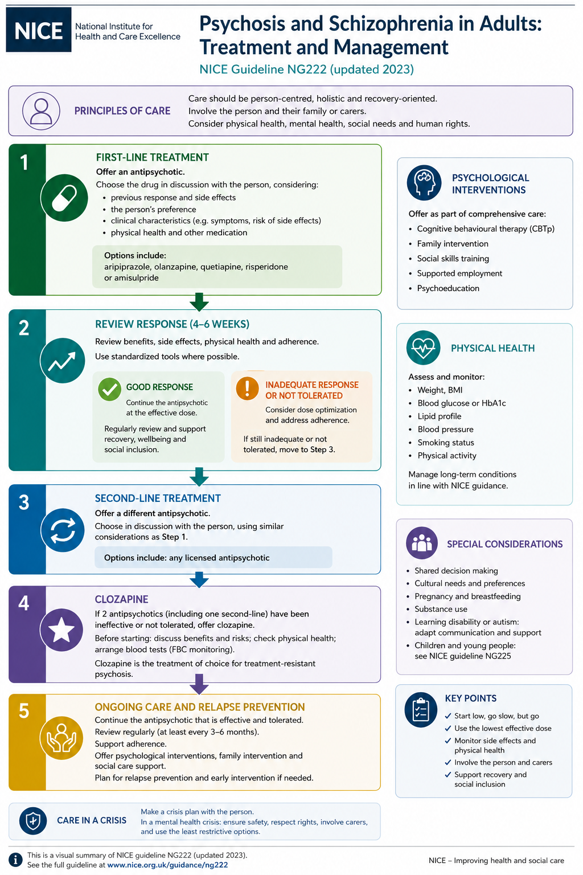

Slide 7
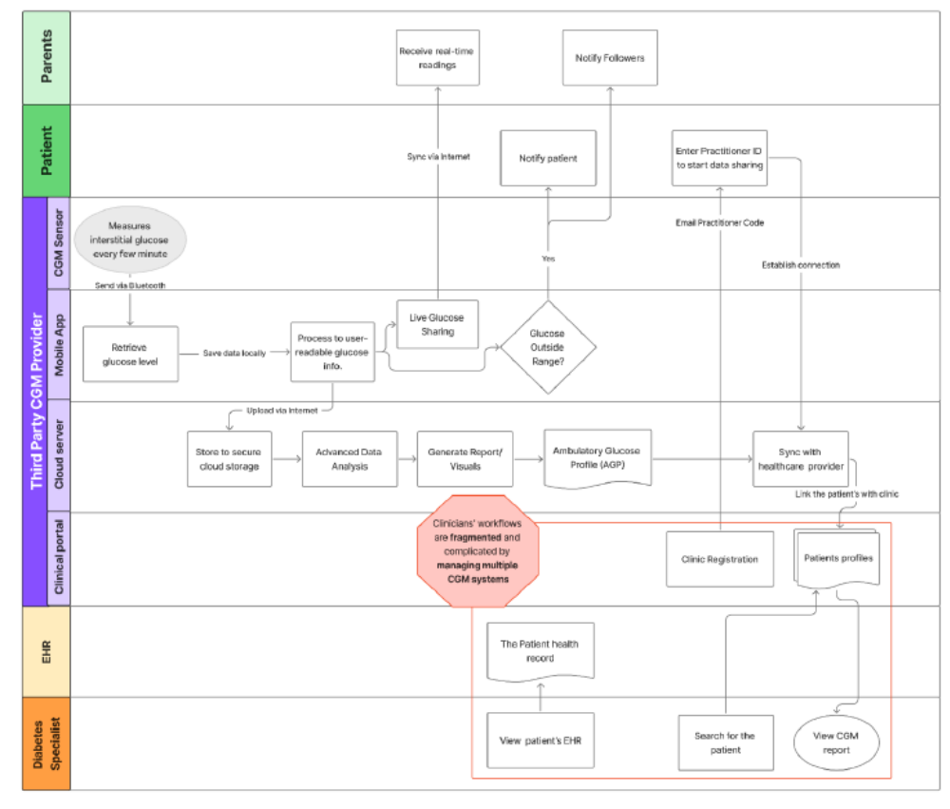
Delivering care is messy – complex systems, multiple interactions, multiple governance, complex feedback

Slide 8
Healthcare systems are complex and adaptive
Many individual agents who act in ways that are not totally predictable
Care crosses many organisational boundaries
The environment in which care is delivered is at the mercy of funding and policy
Question:
Do we see signals of complexity in the system outputs?
Proxy: Many care pathways lead to prescriptions

Slide 9
OpenPrescribing: NHS Medicines Data at Scale
An open national resource for health data science, quality improvement and policy
DATA
Monthly open prescribing data
All GP practices in England
SCALE
Millions of prescription rows
Longitudinal, national coverage
METHODS
EDA • variation • time‑series
Benchmarking & safety signals
IMPACT
Medicines safety
Cost & unwarranted variation
Accessible via OpenPrescribing.net • Bennett Institute for Applied Data Science, University of Oxford

Slide 10
Identify drugs prescribed in a complex chronic condition
Retrieve data on a monthly basis
Correct for seasonality, drift
Look at complexity signals

Slide 11
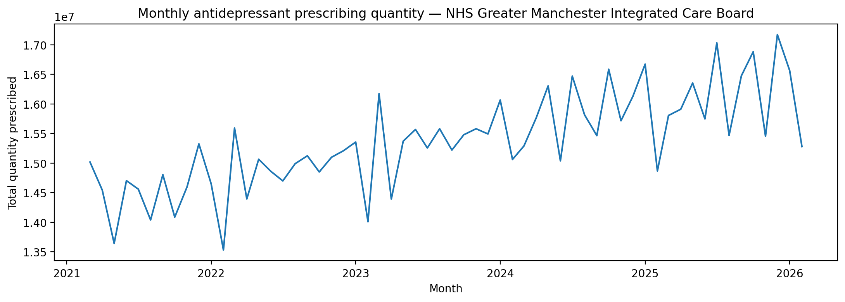
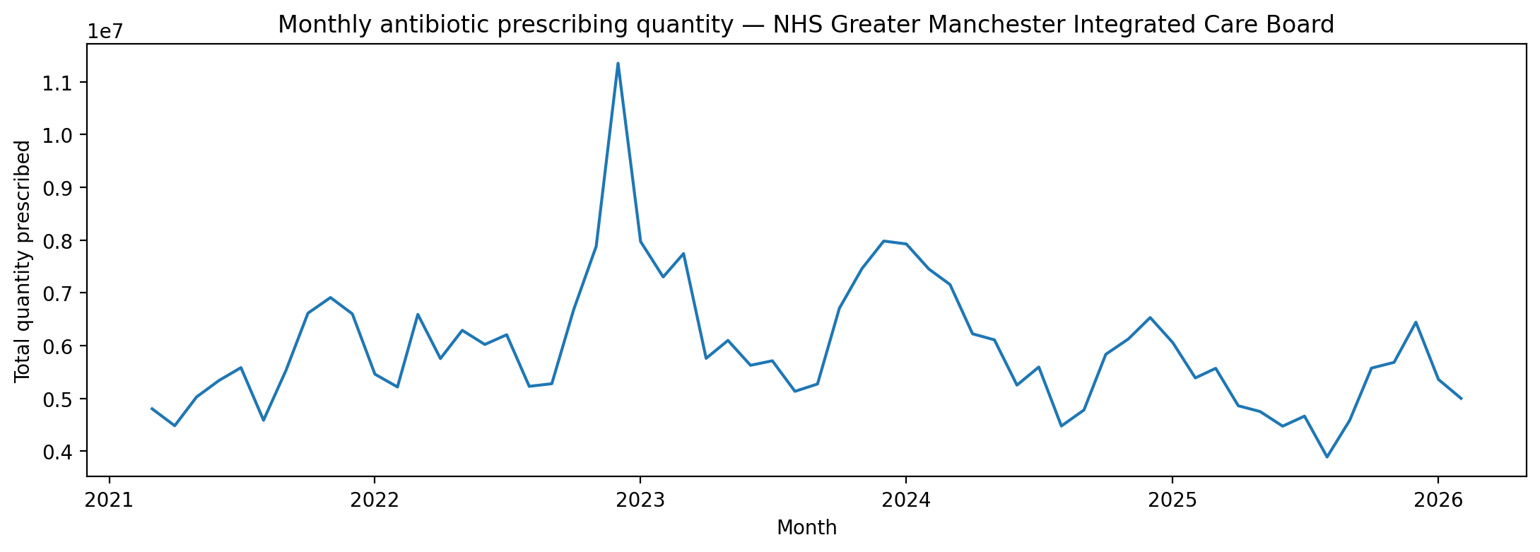

Slide 12
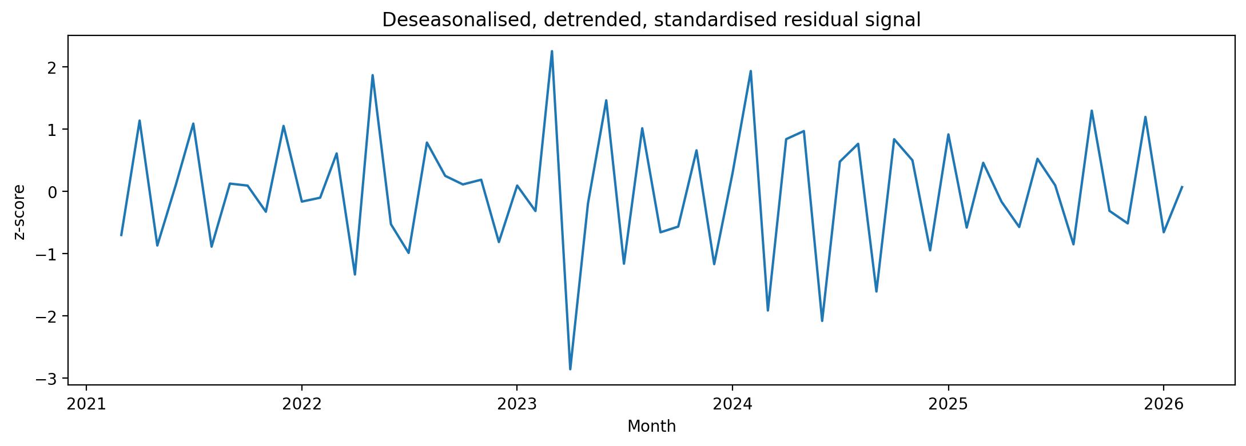
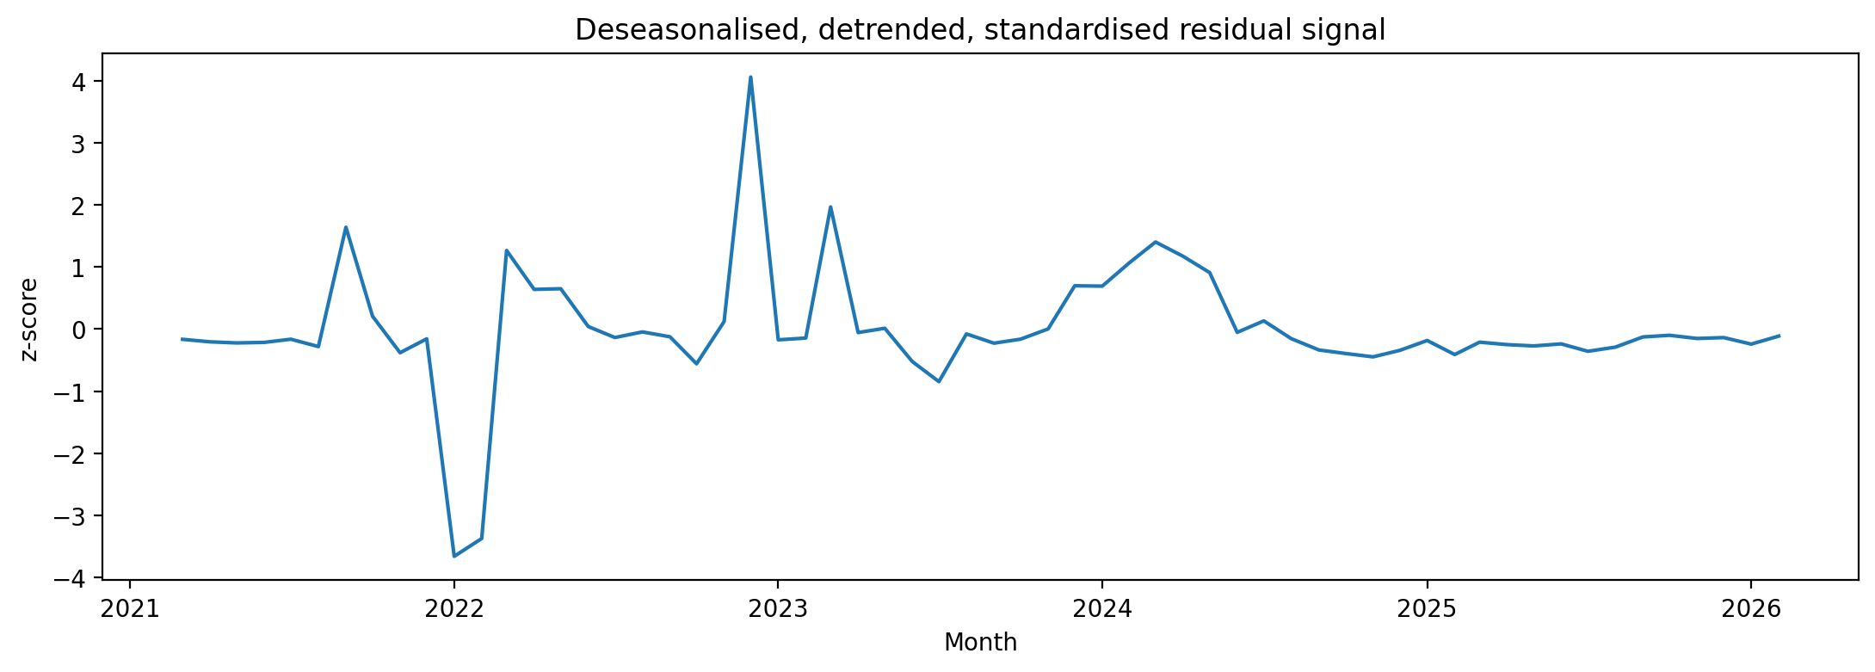

Slide 13
Conclusions
Small positive Lyapunov exponents: ~0.1
Some evidence of nonlinear structure – but not enough data to be conclusive

