Slide 1
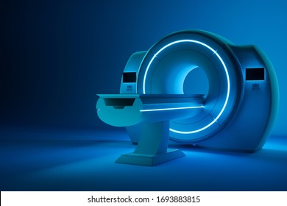
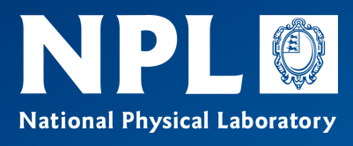
The glorious and terrible complexity of MRI or how I learned to stop worrying and become an experimentalist
Matt G Hall
National Physical Laboratory

Slide 2
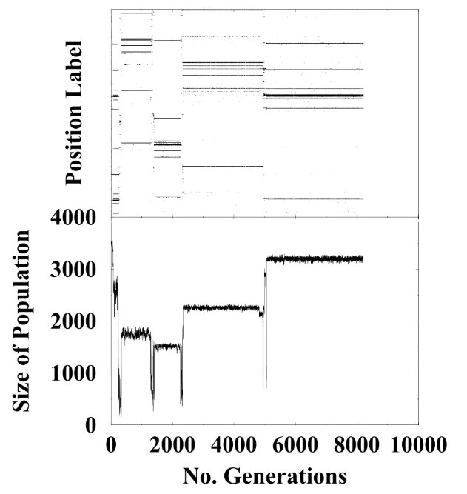
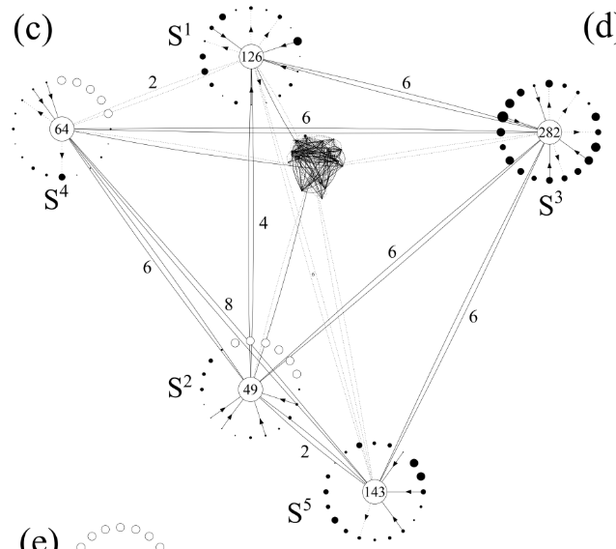
For a brief and wonderful time,
I worked with Henrik
Henrik, Kim Christensen, Simone Collobiano and I worked together on the Tangled Nature model
We worked on the formulation, did the early simulation work, worked out how to visualise the results, and derived basic metrics of its behaviour
Somehow, I managed to get a PhD out of it
Then some other things happened…
… and I’m now an MRI metrologist.
(shortest CV ever…)

Slide 3

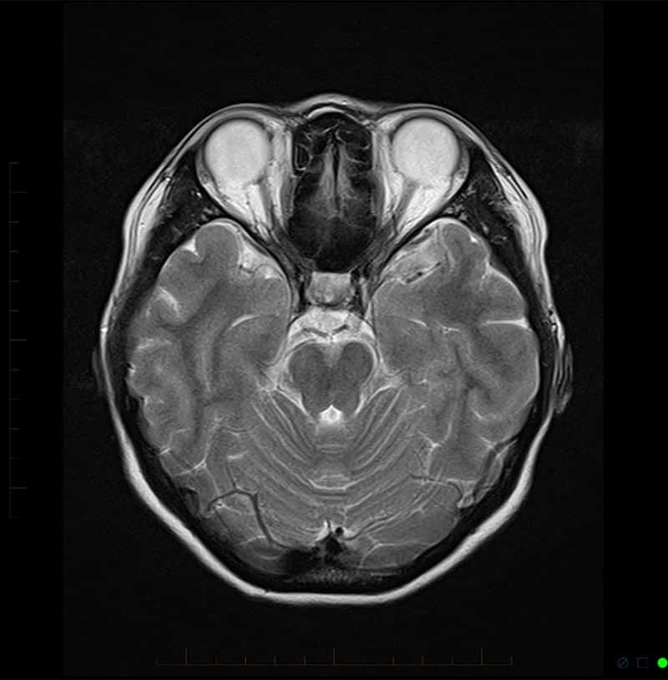
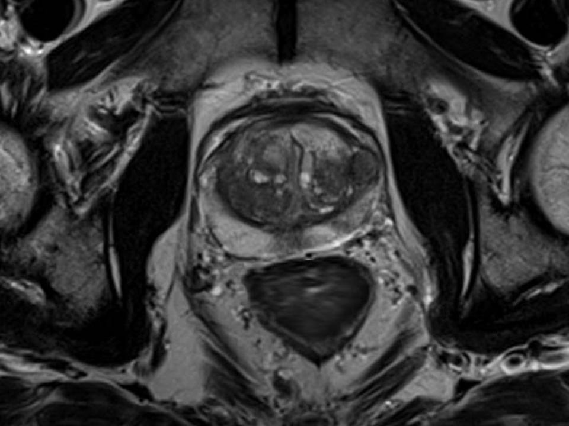
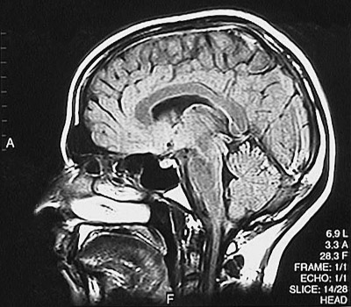
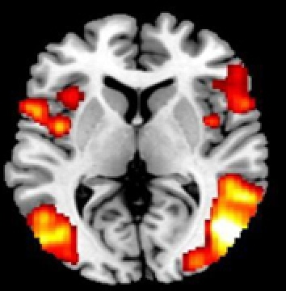
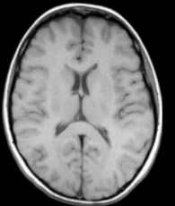
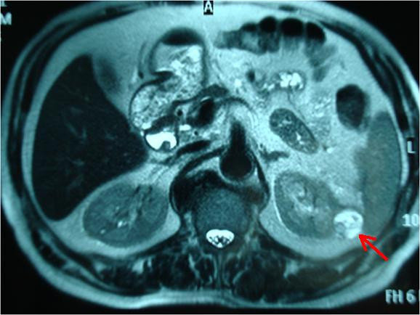
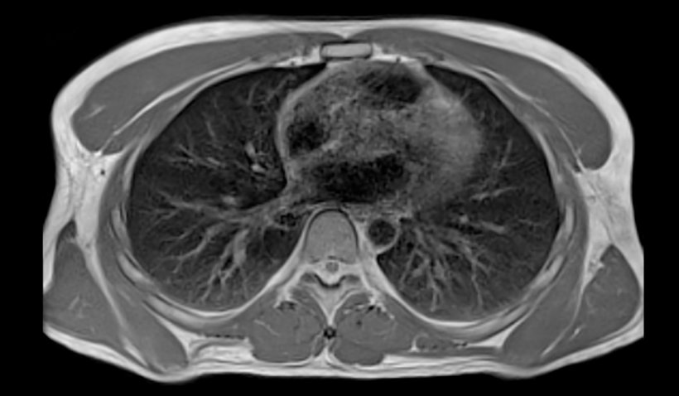
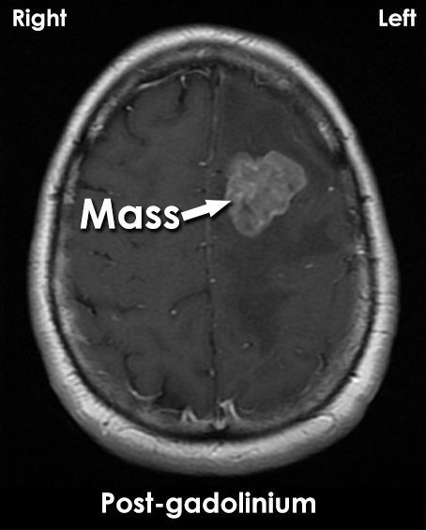
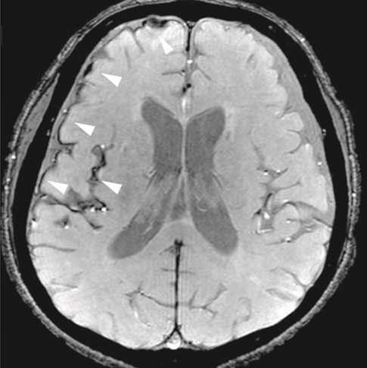
MRI in clinical looks like this

Slide 4

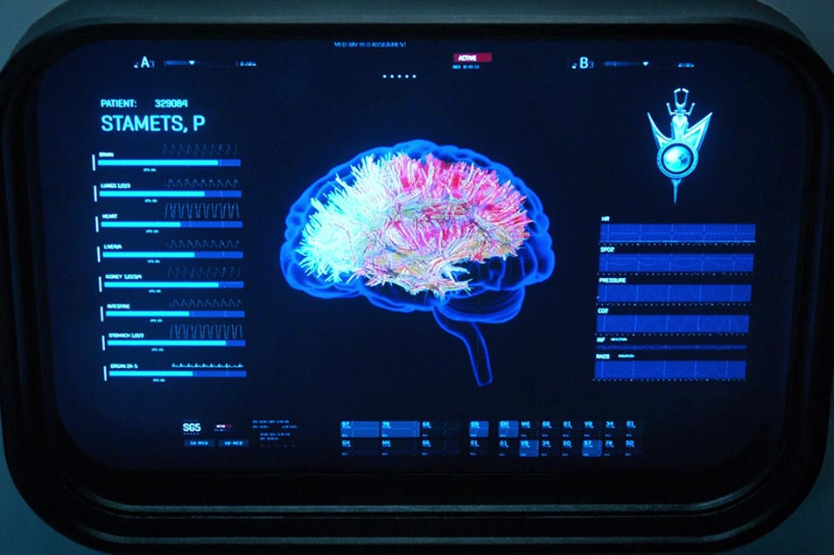
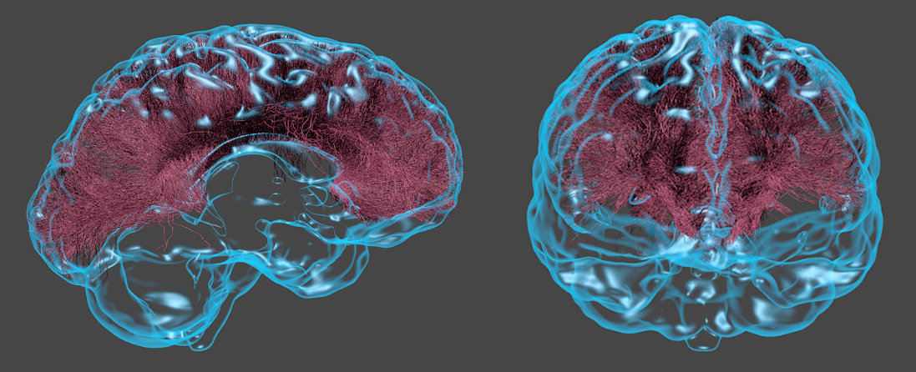
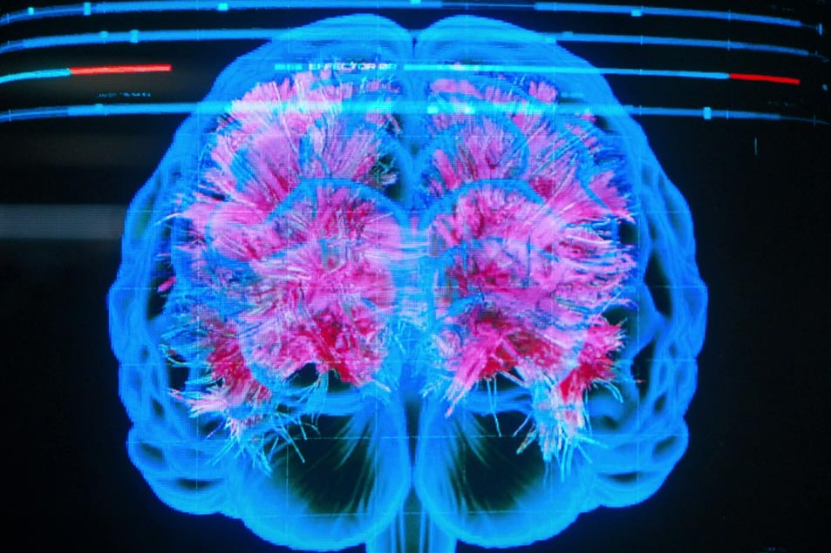
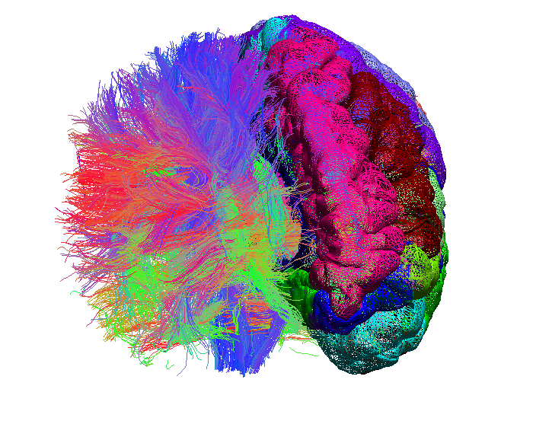
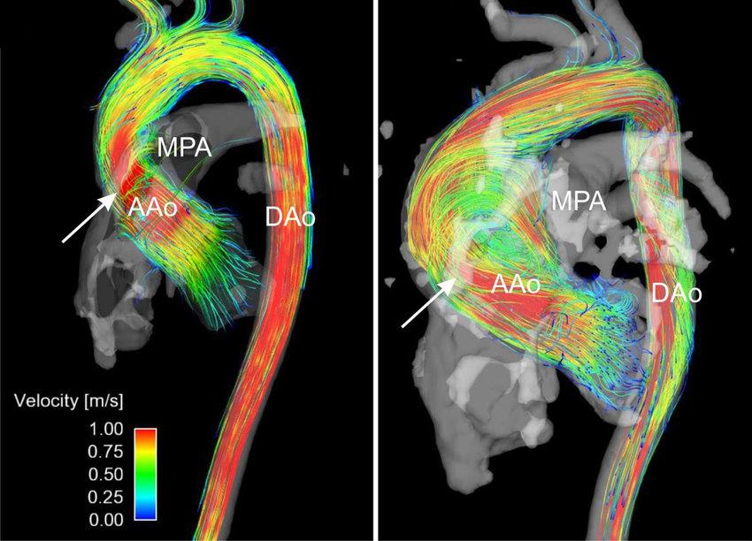
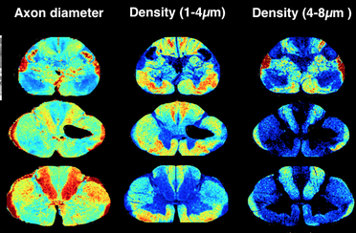
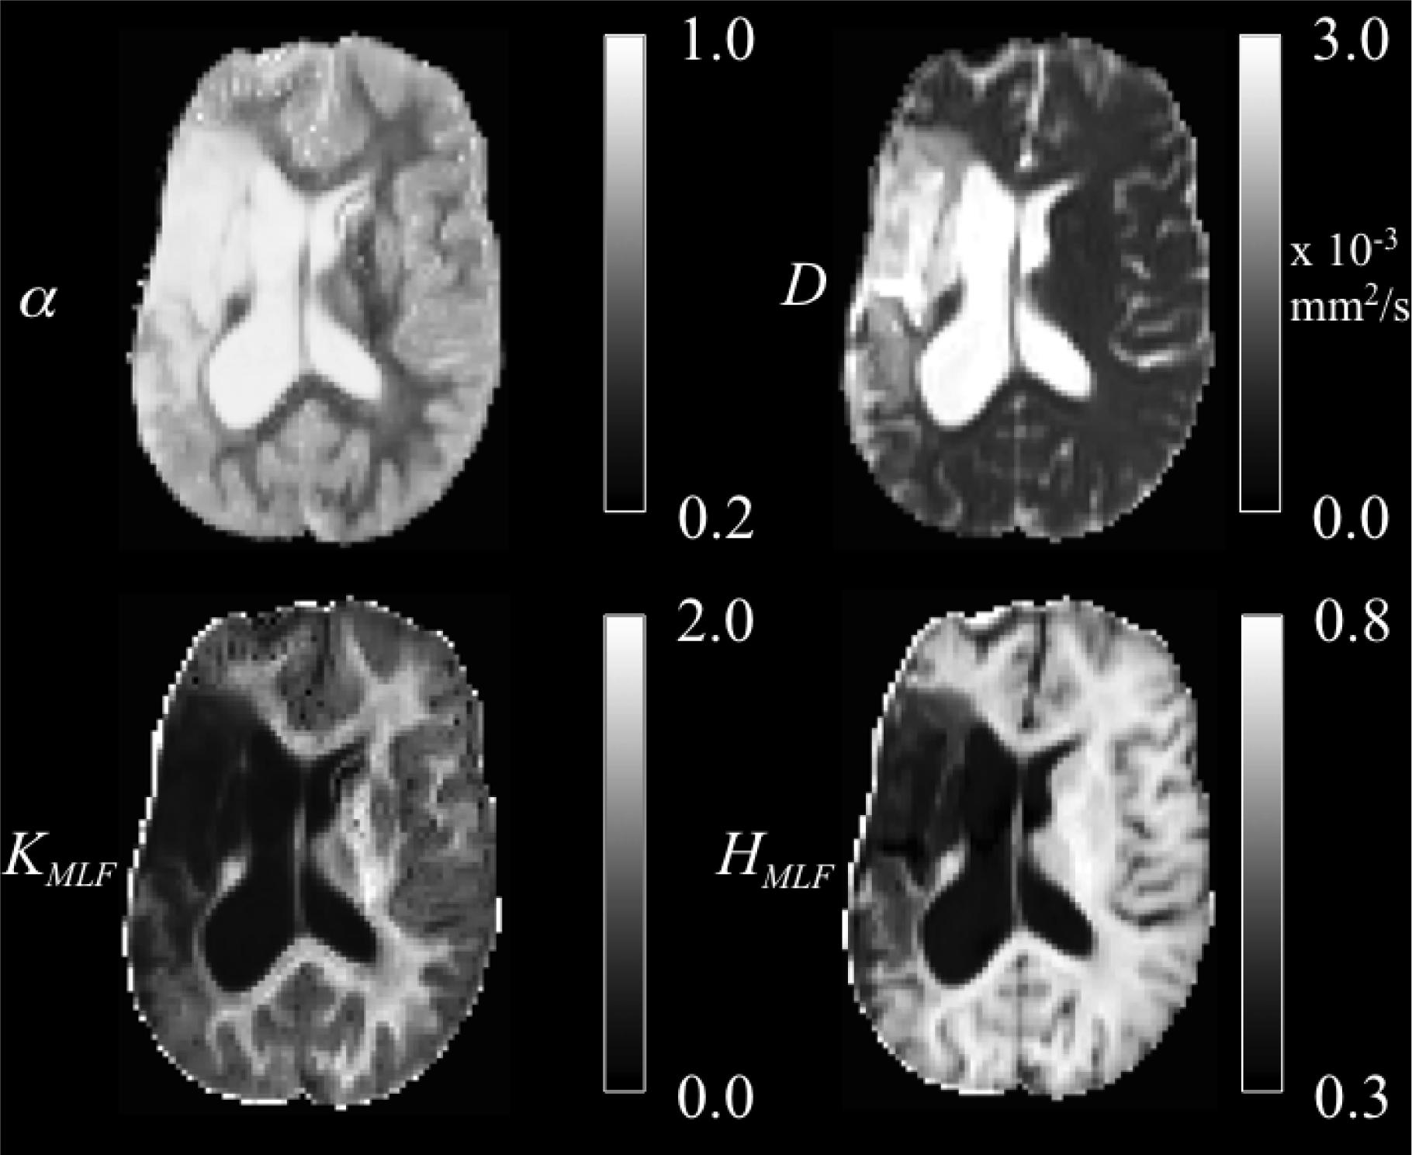
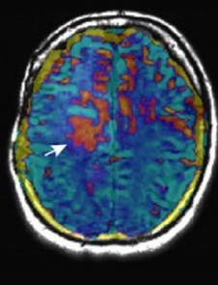
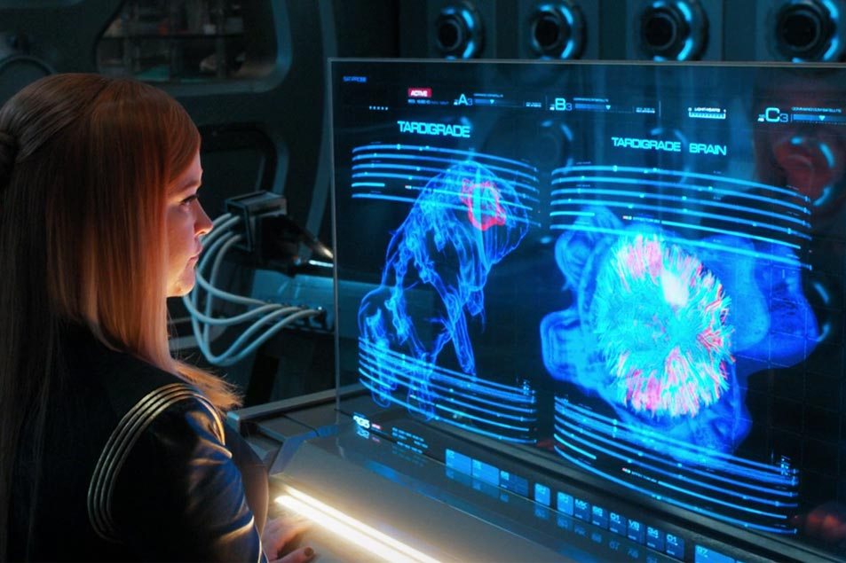
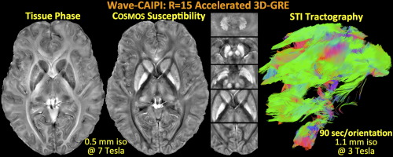
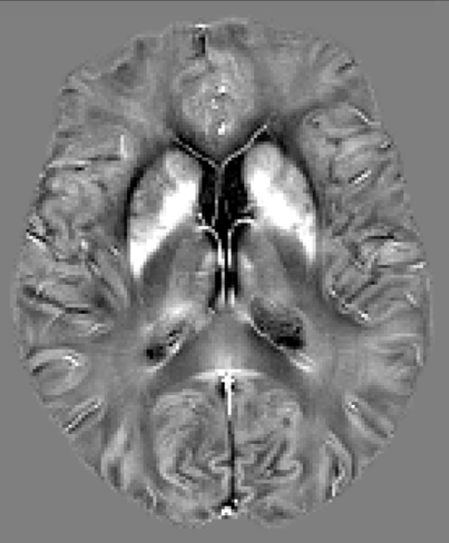
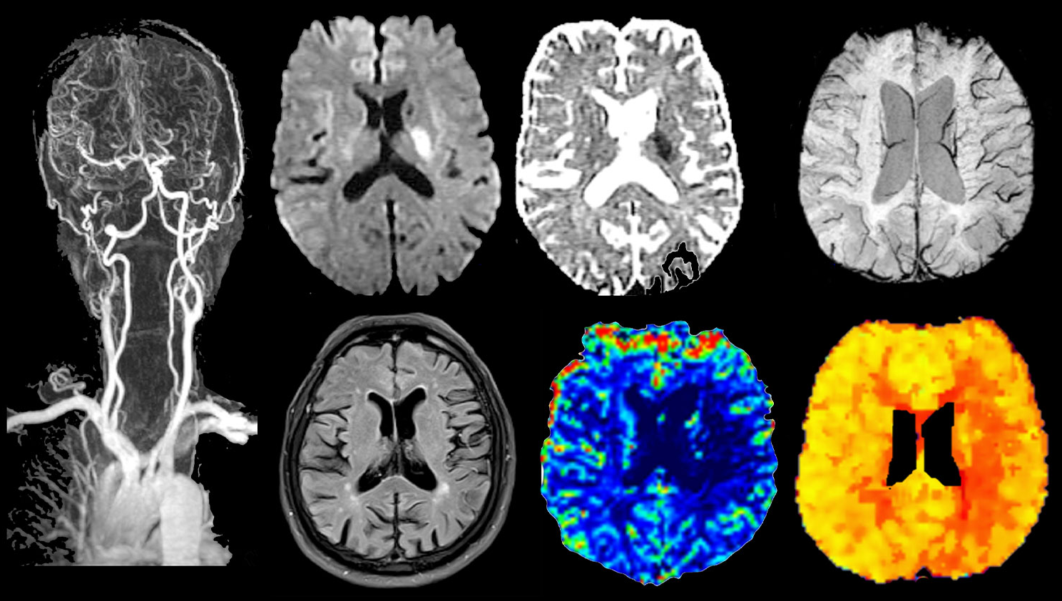
MRI in research looks like this
Image: Kiran Seunarine / DIBS, UCL
Images: Star Trek Discovery Paramount/Skydance

Slide 5
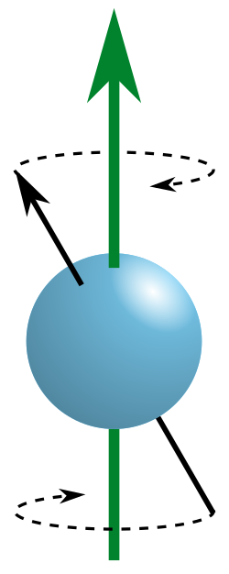

How does it work?
MRI scanners do two things
  Generate contrast
  Form images
Each of these involves manipulating the nuclear spins
(usually talking about hydrogen nuclei in water molecules)
It’s all based on a quantum mecahical phenomenon called Magnetic Resonance
Nuclear spins precess about magnetic field lines at a frequency proportional to the strength of the field
$$ω=γB$$
This is the Larmor Frequency

Slide 6

How does it work?
We can only detect this in the plane transverse to the main magnetic field direction
We can excite spins away from the field and watch how the signal behaves
We do this by adding another magnetic field – this time a time-varying one – at the Larmor frequency
Spins absorb the energy and the spin axis moves further from the field direction
We can move them all to way to 90 degrees away from the field, and then we can measure the effect of the precessing spins!
  It’s also an oscillating magnetic field at the Larmor frequency
  We can detect it via a receiver coil – classical induction
  Same as an electric guitar

Slide 7
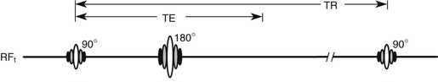
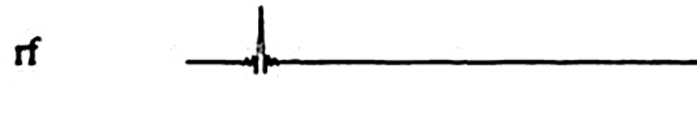
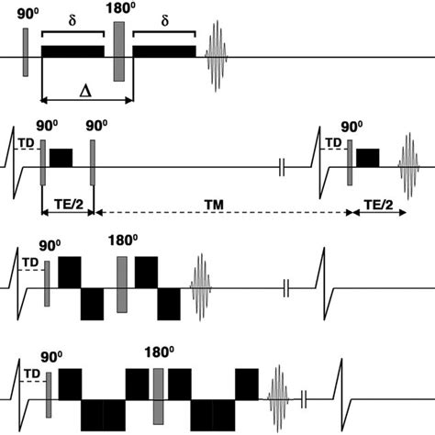
How does it work?
The way we send in the excitation dictates the way the spins behave
We can choose to sensitise the signals to different quantities with different pulse sequences
  Relaxometry (T1, T2)
  Transport (diffusion, flow, exchange)
  Chemical composition (fat/water, other nuclcei)
  Magnetic properties (susceptibility)
This makes the intensities, and the intensities encode the physics we’re looking at
But we need to do more to make an image…

Slide 8
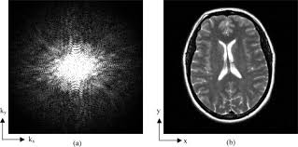
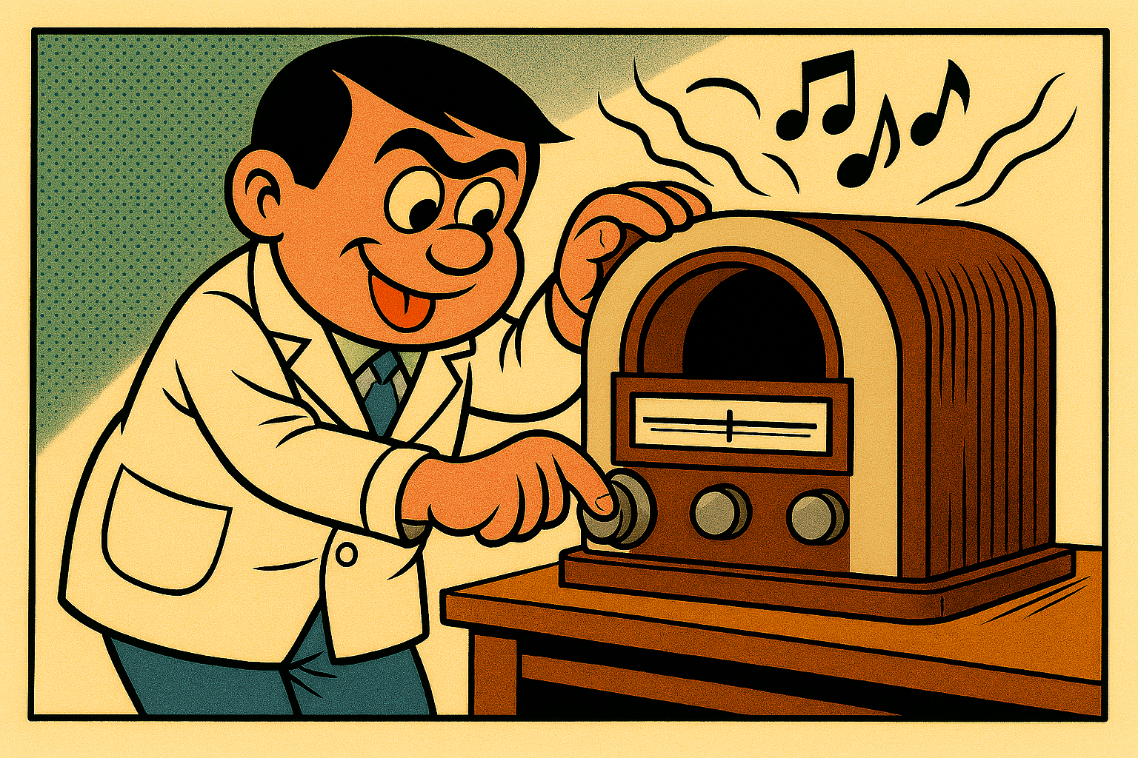
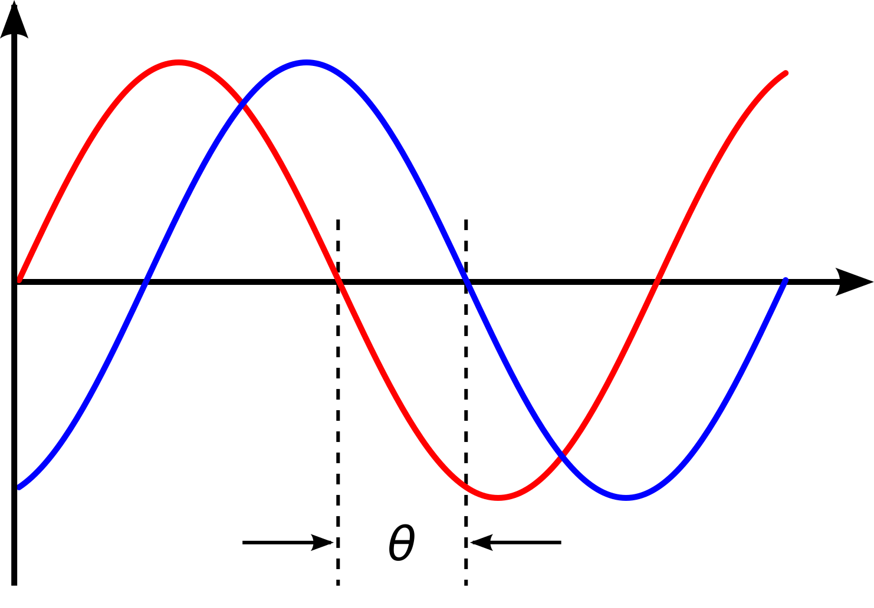
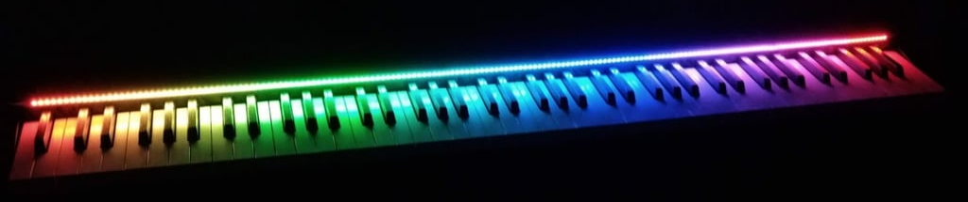

Forming an image
Images are about how things are arranged in space
We need to define three spatial axes, each with their own encoding
In MRI we can do this by varying the strength of the field spatially and temporally
We can isolate a single spatial slice by tuning the Larmor frequency at a chosen distance along a gradient so than only spins at that distance are exited
Adding a different, perpendicular gradient to the field encodes position in the frequency
$$ω=γ(B+Gx)$$
We can do a similar trick with a third perpendicular gradient to affect the signal’s phase (less efficient – can’t superpose phases)
And that give us…
Something that looks nothing like what we want!
But after a quick inverse Fourier Transform…

Slide 9

The MRI measurement pipeline
Patient
Main field geometry
Excited signal: receiver coils
Transmitter coil: B1 field and RF pulse
Coil channel combination
Inverse Fourier Transform: images
Distortion correction / noise reduction
Registration / Postprocessing
Analysis / model fitting
Output maps
Inference (human / AI / stats)
k-space: trajectory and sampling
AI
AI
AI
AI
AI
AI
AI
AI
AI
AI

Slide 10

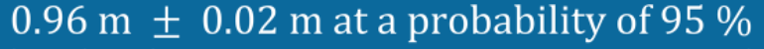
MRI Metrology
Metrologically, a measurement (of a measurand) includes three things:
Measured value is the output of the measurement process
Uncertainty is a statistical statement
Units require a little more development…
Unit
Measured value
Statement of uncertainty

Slide 11

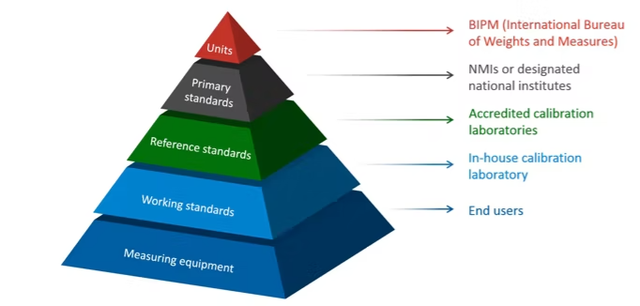
What NPL does
It’s not just about the best measurement, it’s really all about consistency
We need to know a meter is a metre, a second is a sekunde, and a gram is a gramme. Everwhere in the world, and also throughout history and in the future
This comes from the SI system – seven “base” units with internationally-accepted definitions and sets of experiments to realise them
This leads to a set of “primary standards” in each country which are used to calibrate everything else

Slide 12
There’s one more thing
The biological tissues we’re imaging are highly complex
Multiscale structure, heterogenious materials, order and disorder
Active transport, exchange, metabolic activity, movement, dynamically changing
Genetic and genomic factors
Far too many parameters to infer from the data we have
Degeneracy in models
How can we decide what the important parameters are and how should we construct models with the maximum discrimination from the smallest number of parameters?
How do those macro-scale parameters relate to the underlying biology?
How can we quantify and express uncertainty to make meaningful comparisons?

Slide 13
Oh look! Here’s a room full of complexity specialists!
The future of this work has important connections to emergent behaviour and complex systems
How can I go from a microscopic model with millions of parameters to a macroscopic model which tells me what the important, measurable effects are?
This is true in the tissue and in the measurement model.
There is definitely a need for more sophisticated approaches and new concepts
There is potential funding in this
Anyone fancy a coffee?

Slide 14



The National Physical Laboratory is operated by NPL Management Ltd, a wholly-owned company of the Department for Science, Technology, and innovation (DSIT).

