Slide 1


DEPARTMENT OF ONCOLOGY
Cancer as an Evolutionary Process
Stefano Lise
UCL Cancer Institute, London, UK
s.lise@ucl.ac.uk
Symposium on Complexity Science
May 15th, 2026

Slide 2

How Does Cancer Develop?
normal cell
Cancer is a cellular disease
  Cells acquire somatic mutations
It follows Darwinian evolutionary principles
  Variation
  Inheritance
  Selection
It’s a dynamical, evolving system
time
cancer

Slide 3
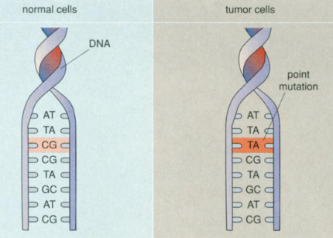
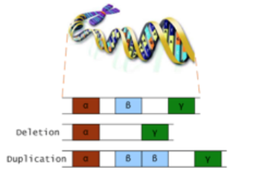
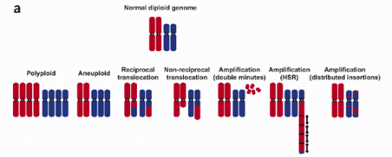
Generating Variation
Causes of somatic mutations
  Endogenous (Internal) Processes: DNA replication errors, DNA damage, …
  Exogenous (External) Factors: radiation (X-rays, UV light, …), chemicals, smoking, …
Transformation from normal to cancer cell may require many years
Often, tumor suppressor genes are inactivated
  BRCA1/BRCA2, TP53, …
Alterations ranges from single-base substitutions to chromosome-level aberrations

Slide 4
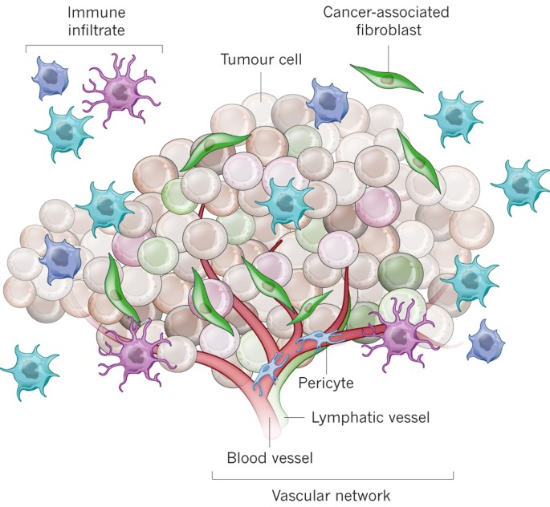
Selection Pressures
The environment determines cell fitness
Several selective pressures:
  Resource limitation
  Immune surveillance
  Therapeutic intervention
The tumor reshapes the environment
The tumor is like an ecosystem

Slide 5
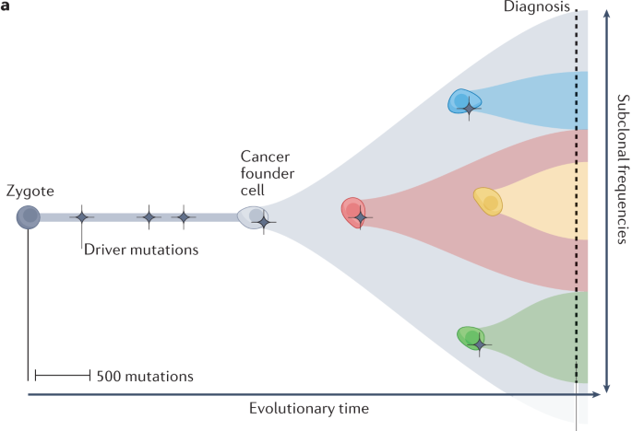
Clonal Evolution
Subclones emerge and expand
Branched evolution
Tumors are not homogeneous
  Spatial and temporal heterogeneity
Seferbekova et al, Nat Rev Genet (2023)
Driver mutation: a mutation that increases the fitness of the cell

Slide 6
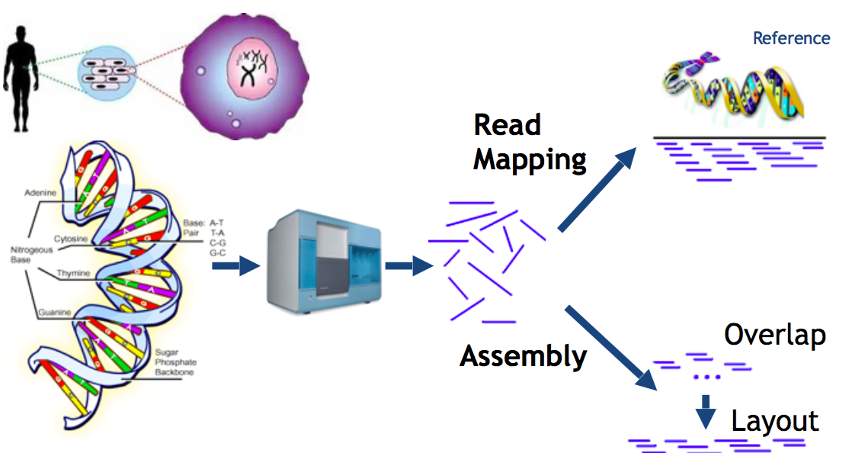
Cancer Genomics
High-throughput technologies enable comprehensive tumor profiling
  DNA sequencing
  RNA sequencing
  Single-cell and spatial genomics
  Methylation
  …
Genomic data support the evolutionary framework
  Tumours are genetically diverse with multiple coexisting subclones
  Parallel evolution across sites/metastasis

Slide 7
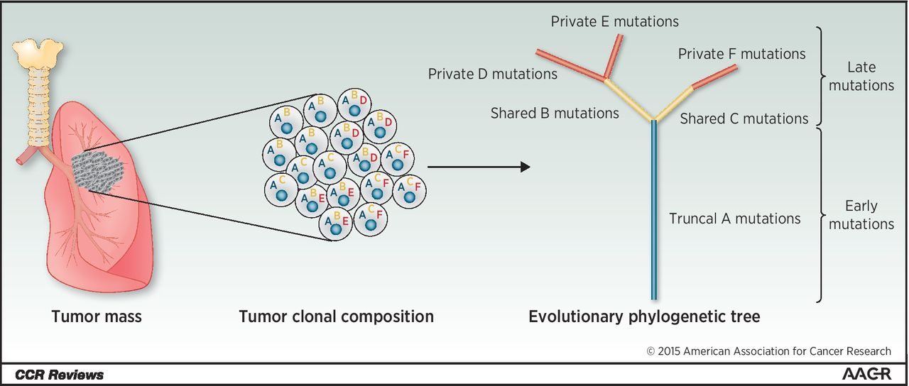
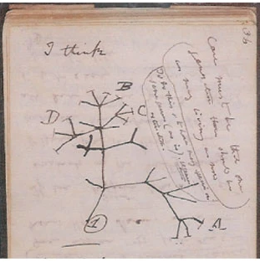
Phylogenetic Tree Analysis
Tracing tumour life history
Mariam Jamal-Hanjani et al. Clin Cancer Res (2015)
Darwin (1837)

Slide 8
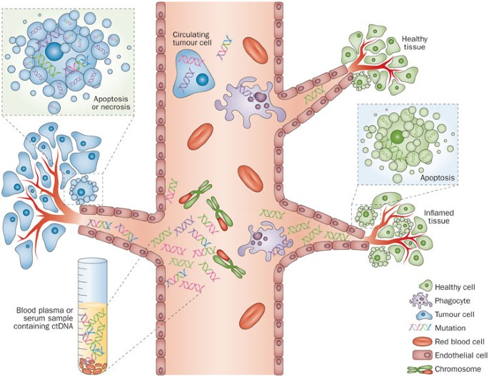
Liquid Biopsies
Tumour DNA is shed into the bloodstream
It is a minimally invasive test
  Tissue biopsy sampling is restricted
It can track tumor evolution in real time
Crowley E, et al. Nature Reviews Clinical Oncology (2013)

Slide 9
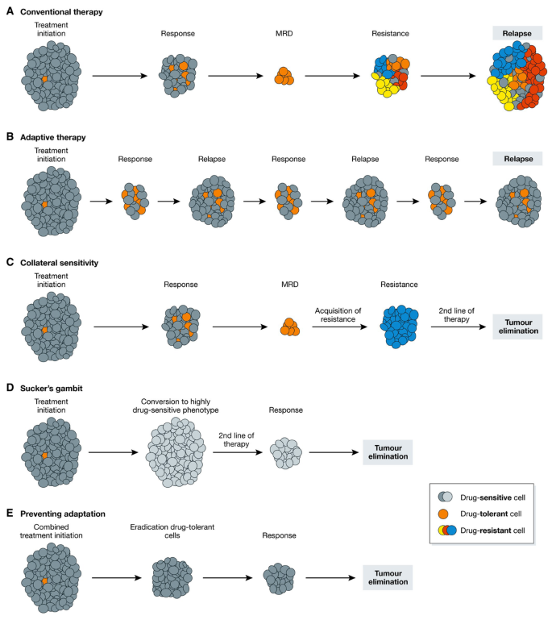
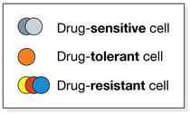
Therapy as Selection
Therapy acts as a strong external selective pressure
  Sensitive cells are eliminated
  Resistant cells survive and expand
  E.g. cells with alterations in the Androgen Receptor (AR) gene in prostate cancer under Androgen Deprivation Therapy (ADT)
*
* MRD: Minimal Residual Disorder
Vendramin et al, EMBO J (2021)

Slide 10
Clinical Implications
Clinical challenges
  Relapse despite initial response
  Variable outcome across patients
Evolutionary-based treatment strategies
  Combination therapies to limit evolutionary escape routes
  Adaptive therapy (manage, don’t eradicate)
  Monitoring evolution (liquid biopsies)
Adaptive therapy
Vendramin et al, EMBO J (2021)

Slide 11




Prostate Cancer
Slow-growing cancer
Treatment is sometimes not required
  “More men die with prostate cancer than because of it”
Could we identify more aggressive cancers at diagnosis?
  Are there molecular determinants of progression?
The ReIMAGINE prostate cancer risk study
  ~ 1, 000 men recruited
  Clinical, imaging and molecular data

Slide 12
Advanced Disease Study
Serial liquid biopsies integrated with post-mortem tissue samples
Detailed clinical information
Accurate reconstruction of clonal evolution and selection through treatment history
  Link treatment to clonal dynamics
  Provide insights into treatment resistance mechanisms

Slide 13
Conclusion
Cancer is a heterogeneous, evolving system that follows Darwinian evolution
The evolutionary perspective is essential for understanding progression and treatment resistance
Evolution-aware strategies might improve treatment
“Nothing in Biology Makes Sense Except in the Light of Evolution” (Theodosius Dobzhansky)

Slide 14
Conclusions
Cancer is a heterogeneous, evolving system that follows Darwinian evolution
The evolutionary perspective is essential for understanding progression and treatment resistance
Evolution-aware strategies might improve treatment
“Nothing in Cancer Makes Sense Except in the Light of Evolution” (Prof Mel Greaves, Founding Director, Centre of Evolution and Cancer, The Institute of Cancer Research)

